Slide 1
Cryptographic Hash Function
CS 5352/6352 Computer Security
Lecture note
Dr. Sajedul Talukder

Slide 2
Cryptographic Hash Function
A hash algorithm is a one-way function that converts a data string into a numeric string output of fixed length. The output string is generally much smaller than the original data.
Therefore it is also called message digest or message compression algorithm.
Hashing provides constant time search, insert and delete operations on average. Hash functions are extremely useful and appear in almost all information security applications
  Message Digest
  Password Verification
  Data Structures (Programming Languages)
  Compiler Operation
  Rabin-Karp Algorithm (String Matching)
  Linking File name and path together

Slide 3
One-way Hash Function
The notion of a one-way function is central to public-key cryptography.
A one-way hash function is a mathematical function which takes a variable-length input string (called pre-image) and converts it into a fixed-length binary sequence (called hash value).
♣
It is also known as a message digest, fingerprint or compression function,
Furthermore, a one-way hash function is designed in such a way that it is hard to reverse the process, that is, it is easy to compute a hash value from pre-image but it is hard to generate a pre-image that hashes to a particular value.
♣

Slide 4
One-way Hash Function
A one way hash function H(M) operates on an arbitrary length pre-image message M, and return a fixed length hash value h.
h=H(M) ,where h is the length of m

Slide 5
Application: Hashing Password
Hashing passwords: It's a bad idea for computer systems to store passwords in cleartext (in their original form), because if the bad guy can somehow get to where they're stored, he gets all the passwords.
Knowing how many people foolishly use one password at multiple sites, getting a stash from one system may give access to others.
A more secure way is to store a hash of the password, rather than the password itself. Since these hashes are not reversible, there is no way to find out for sure "what password produced this hash?" - and the so consequence of a compromise is much lower.

Slide 6
Application: Hashing Password
Original Password
“Hello”
Hash Algorithm
How password is
stored using hash
Hashed Password
9a46ba811185c194762
Hash of the Password Stored

Slide 7
Applications of Hash: Verification
Wrong Password
“World”
Hash of the Password Stored
Hash Algorithm
How password
Hash Value Mismatched
er4a46b7w0534894789
9a46ba811185c194762
is
verified using hash
[No]
Do Hashes Matched?
[Yes]
Access Denied
Access Granted

Slide 8
Application: Verifying the Data Integrity
Verifying file integrity The most obvious use is "verifying file integrity".
If you have just downloaded a large piece of software from a website, how do you know that you've received it correctly and that it has not been tampered with?
One way is to download the file again and compare the bits: if the bits are the same, you're probably ok, but if they're different, which ones are the right bits?
Finding out means yet another download with compare, and this gets very tedious very quickly. Instead, if the website publishes the hash values of its download bundles, you can check it yourself.

Slide 9






Application: With Digital Signature
♣ Hashing is to digest the original message while signing the document digitally.
Private Key
Hash of Document
I agree to pay
$50 for the software
Hash Algorithm
er4a46b7w05348 94789
Encrypt
Document to be
Signed
43985dlfslfnsv90 64klj79dsflk6
Digital Signature

Slide 10
Hashing Methodologies
When designing and implementing hash functions the common building blocks typically used are bitwise operations, mathematical operations and look-up tables.
These operations are applied either to individual bytes or blocks of bytes (words etc), furthermore they are fast, deterministic and readily available on most CPU architecture, making them ideal for implementing hash functions.
The following is a list of the commonly used operations:
  Bitwise Operations: Not (!), Or (|), And (&), Xor (^), Shift-Left/Right (<<, >>), Rotate-Left/Right (<<<, >>>)
  Mathematical Operations: Addition (+), Multiplication (*)
  Lookup Tables: List of prime numbers, List of magic numbers, S-Box, P-Box

Slide 11
Hashing Methodologies
Initialize an internal state
Consume the message N-bits at a time (aka block size typically 32-bits, 64-bits, 128-bits etc..)
Perform a mixing operation with the current block and the internal state
Update the internal state with the the result of previous step
If there are any remaining bytes in the message proceed to step 2
Finalize the internal state and return the hash value

Slide 12
Hashing Methodologies: Mixing/Compression

Slide 13
Hash Function Properties

Slide 14
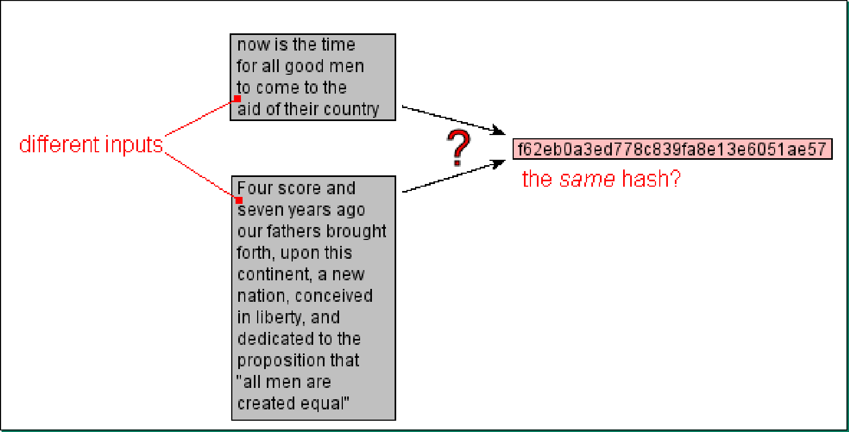
Hash Collision
♣ When different input message results in the same hash value, then it is called hash collision.

Slide 15
Collision Resistance
A slight change in an input string should cause the hash value of the function to change drastically. Even if 1 bit is flipped in the input string, at least half of the bits in the hash value will flip as a result. This is called an avalanche effect.
Since it is computationally infeasible to produce a document that would hash to a given value or find two documents with the same hash value.
As there is almost no chance to have the same hash value of two different messages, so it is called collision free or collision resistant.
A document's hash can serve as a cryptographic equivalent of the document. This makes a one-way hash function a central notion in public-key cryptography.

Slide 16
Collision Resistance
♣ It is hard to find two inputs that hash to the same output; i.e., it is hard to find any two inputs a and b such that H(a) = H(b), and a ≠ b.

Slide 17
Preimage Resistance
♣ This property means that it should be computationally hard to reverse a hash function.
♣ In other words, if a hash function h produced a hash value z, then it should be a difficult process to find any input value x that hashes to z.
♣ This property protects against an attacker who only has a hash value and is trying to find the input.

Slide 18
Preimage Resistance
♣ For essentially all pre-specified outputs, it is computationally infeasible to find any input which hashes to that output, i.e., it is hard to find any message 𝑥 with 𝐻(𝑥) = ℎ.

Slide 19
Second Preimage Resistance
♣ This property means given an input and its hash, it should be hard to find a different input with the same hash.
♣ In other words, if a hash function h for an input x produces hash value h(x), then it should be difficult to find any other input value y such that h(y) = h(x).
♣ This property of hash function protects against an attacker who has an input value and its hash, and wants to substitute different value as legitimate value in place of original input value.

Slide 20
Second Preimage Resistance
♣ It is computationally infeasible to find any second input which has the same output as a specified input, i.e., given x, it is difficult to find a second preimage x' ≠ x such that H(x) = H(x′).
You owe me $5
b3f9b3a3504ccb29c4183730a42c8d56
You owe me $5000
Impossible!

Slide 21
Construction of a Secure Hash Function
Message m |  | 100…000 | length
Padding & length encoding
M₁
M₂
M₃
M_{t}
b
n
b
f n
b
b
. . .
n
^{H}t-1
f
n _{H}
t
g
IV=H
n
f
f
n
0
H₁
H₂
Legend:
IV : Initial Value
H_{i} : i-th Chaining variable
M_{i} : i-th input block
f : Compression function
g : Output transformation (optional)
t : Number of input blocks
b : Block size in bits
n : Hash code size in bits
h(m)

Slide 22
Construction of a Secure Hash Function
M_{i}
b
Compression
Function
(fixed-size hash function)
n
n
f
H_{i}
^{H}i-1
Entire hash
H₀ = IV
H_{i} = f (H_{i-1}, M_{i}) for 1 ≤ i ≤ t
H(m) = g(H_{t})
Fact (by Merkle-Damgård)
Any collision-resistant compression function f can
be extended to a collision-resistant hash function h

Slide 23
Typical Hash Padding
Assume Block size = 512 bits (MD5, SHA1, RMD160, HAS160 …)
Last 512-bit block
Message m |  | 100…000 | length
Let r = |m| mod 512
If 512-r > 64
padding = 512-(r+64) bits
else
padding = 512-r+448 bits (two padding blocks)
64 bit integer (bit-length of message m)

Slide 24
Trapdoor One-way Function
A trapdoor one-way function is a special type of one-way function, one with a secret trapdoor. It is easy to compute in one direction and hard to compute in the other direction. But, if you know the secret, you can easily compute the function in the other direction.
That is, it is easy to compute f(x) given x, and hard to compute x given f(x). However, there is some secret information, y, such that given f(x) and y it is easy to compute x.
A watch is a good example of a trap-door one-way function. It is easy to disassemble a watch into hundreds of pieces. It is very difficult to put those tiny pieces back together into a working watch. However, with the assembly instructions it is much easier.

Slide 25
Classification of Hash Functions
Dedicated (Customized)
Based on block ciphers
Based on Modular Arith.
MD2
Broken
MDC-1 MDC-2 MDC-4
MASH-1
Broken MD4
Broken
MD5
Broken SHA0
RIPEMD-128
Reduced round
Version broken
HAS-160
Weakness discovered
SHA1
RIPEMD-160
SHA2

Slide 26
Hash Functions In Use Today
There are literally thousands of named hashing functions. Some are secure, but comparatively slow to calculate. Some are very fast, but have more collisions. Some are close to perfectly uniformly distributed, but very hard to implement. Some widely used ones are:
  Hashed Message Authentication Code (HMAC): Combines authentication via a shared secret with hashing.
  Message Digest 2 (MD2): Byte-oriented, produces a 128-bit hash value from an arbitrary-length message, designed for smart cards.
  MD4: Similar to MD2, designed specifically for fast processing in software.
  MD5: Similar to MD4 but slower because the data is manipulated more. Developed after potential weaknesses were reported in MD4
  Secure Hash Algorithm (SHA): Modeled after MD4 and proposed by NIST for the Secure Hash Standard (SHS), produces a 160-bit hash value.

Slide 27
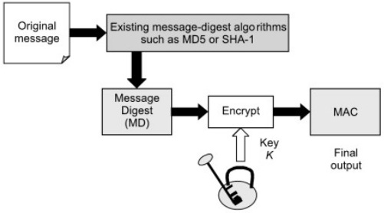
Hashed Message Authentication Code (HMAC)
HMAC (sometimes expanded as either keyed-hash message authentication code or hash-based message authentication code) is a specific type of message authentication code (MAC) involving a cryptographic hash function and a secret cryptographic key.
First published in 1996 in a paper by Mihir Bellare, Ran Canetti, and Hugo Krawczyk.
HMAC function is a technique for verifying the integrity of a message transmitted between two parties that agree on a shared secret key.
HMAC combines the original message and a key to compute a message digest function.

Slide 28
Hashed Message Authentication Code (HMAC)
Let's say a client application downloads a file from a remote server.
Before the server sends out the file, it first obtains a hash of that file using the SHA2 hash function. It then sends that hash (a.k.a. message digest) along with the file itself.
Upon receiving the file and the hash, the client obtains the SHA2 hash of the downloaded file and then compares it with the downloaded hash.
If the two match, then that would mean the file was not tampered along the way.

Slide 29
MD2 Hashing
♣ Both MD2 was invented by Ron Rivest . MD stands for Message Digest. The algorithms produce 128-bit hash values.
♣
It takes a message of arbitrary length as input and produces a 128 bit “fingerprint” or “message digest” or hash value as output .
It is computationally infeasible to produce two messages having the same message digest.
This algorithm has influenced the posterior algorithms like MD5, SHA and RIPEMD.
MD4 is used to compute NTLM password-derived key digests on Microsoft Windows NT, XP, Vista and 7

Slide 30
MD2 Hashing
MD2("The quick brown fox jumps over the lazy dog")
= 03d85a0d629d2c442e987525319fc471
Even a small change in the message will (with overwhelming probability) result in a completely different hash, e.g. changing d to c:
MD2("The quick brown fox jumps over the lazy cog")
= 6b890c9292668cdbbfda00a4ebf31f05
The hash of the zero-length string is: MD2("") = 8350e5a3e24c153df2275c9f80692773

Slide 31
MD2 Algorithm Steps
Padding: Message is padded to make it 16n octets.
Checksum: A 16 octet checksum is computed and appended
Final Pass: 16(n+1) octets are hashed using 18 rounds
Padding: padded bytes contain length of pad Always pad (even if a multiple of 16).
Original Message
R octets (1 < r <16) each containing r
Multiple of 16 octets

Slide 32
Why Always Pad?
31B message
32B Message
1
Message 1 is not a multiple of 16 and so it is padded with 15 in 15 bytes
Message 2 is a multiple of 16 but contains 15
If message 2 is not padded, both these messages will have hash. ⇒ It is trival to find collision.

Slide 33
Brute Force Attack: One-Way Hash Functions
Given y, find m such that
h(m) = y
m_{i}
for i = 1, 2, . . . 2^{n}
h
Arbitrary message m
Or
m of the same meaning ?
h(m_{i})
h(m_{i}) = y ?
n bits

Slide 34
Finding Collision : One-Way Hash Functions
Find any two distinct messages m, m′ such that h(m) = h(m′).
m_{i} for i = 1, 2, . . . 2^{m}
m_{i}′
h
h
How large m should be
to get a match ?
h(m_{i})
h(m_{i}′)
n bits
n bits

Slide 35
MD2 Insecurity
128-bit digest should have 2¹²⁸ tries to break using brute force
2004: Shown to have 2¹⁰⁴ time complexity (rather than 2¹²⁸)

Slide 36
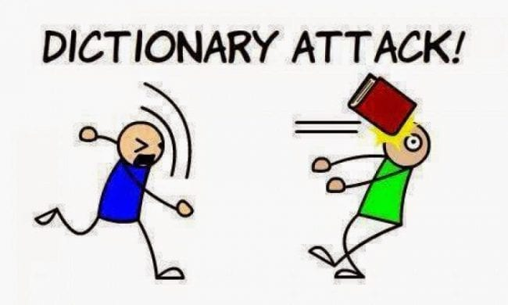
Dictionary Attacks
A type of Brute-Force attack that uses a list of words to gain access to someone’s password
Work on the premise that most internet users still create passwords that are easy to guess
Easy passwords are passwords that use:
  A user’s name or a variation of it
  The name of a user’s relative
  A pet’s name
  Favorite food/drink/car/something
  Birthdays and anniversaries
  A simple numerical combination

Slide 37
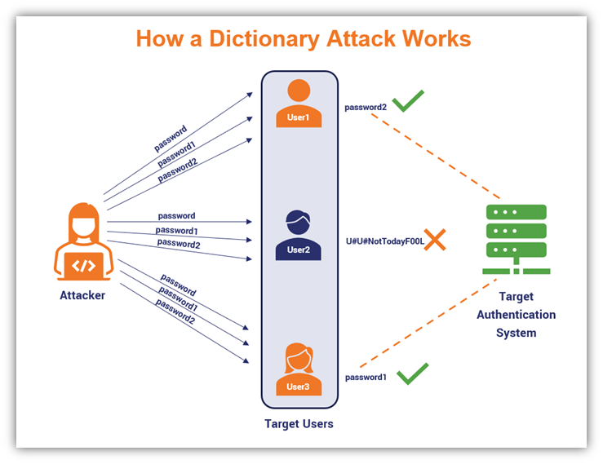
Dictionary
Attacks
How it works?
https://www.thesslstore.com/blog/brute-force-attack-definition-how-brute-force-works/

Slide 38
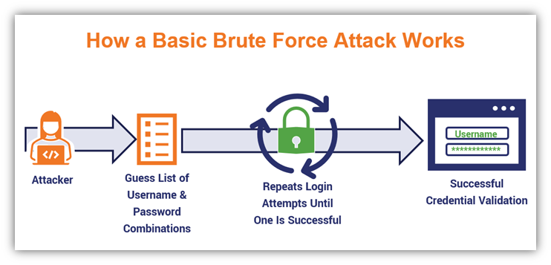
Brute Force Attack
Try all possible passwords

Slide 39
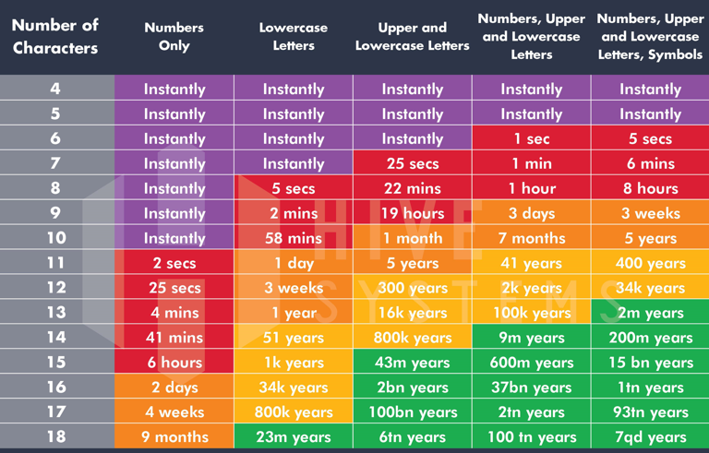
Brute
Force
Time it takes for brute force:

Slide 40
User Accounts
Storing user credentials
  Username, DOB, Email, etc.
  And password
Passwords are stored in ‘hashes’ rather than cleartext

Slide 41
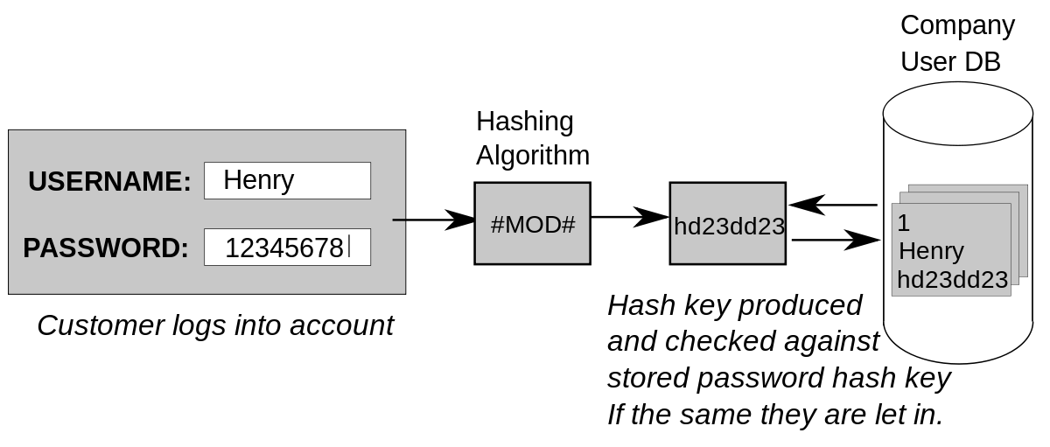
How to login
1. The user creates an account
2. Their password is hashed and stored in the database
  At no point is the plain-text (unencrypted) password ever written to the hard drive
3. When the user attempts to login, the hash of the password they entered is checked against the hash of their real password (retrieved from the database)
4. If the hashes match, the user is granted access
  If not, the user is told they entered invalid login credentials
-- Steps 3 and 4 repeat every time someone tries to login to their account

Slide 42
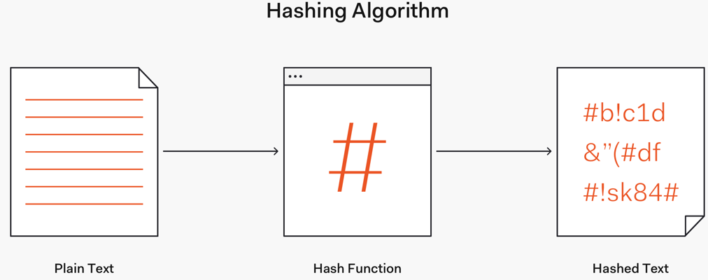
Hashing
A hash function is any function that can be used to map data of arbitrary size to fixed-size values

Slide 43
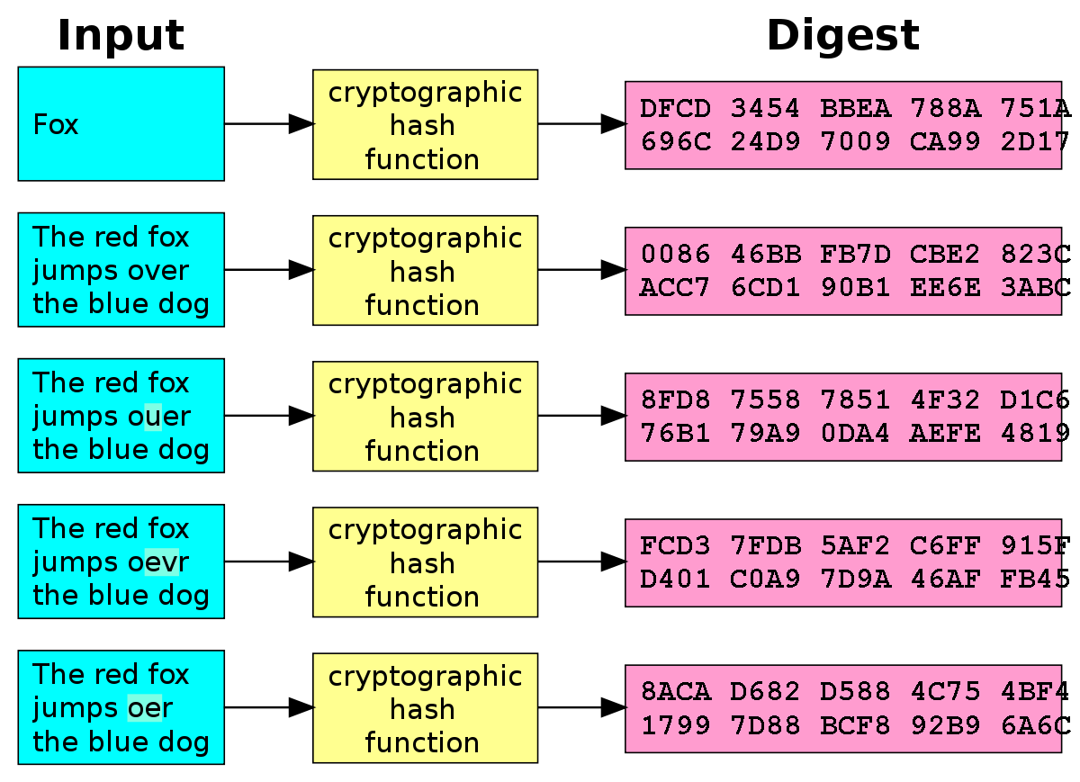
Hashing
Fixed-length output no matter what input is given

Slide 44
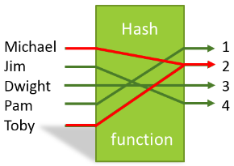
Hashing
No collisions
  A collision occurs when two different inputs to the same hashing algorithm produce the same output
  But the reality is that with a fixed-length output, a collision is possible
  So the goal is to make it so unlikely
Hashes are how Linux/Windows stores passwords

Slide 45
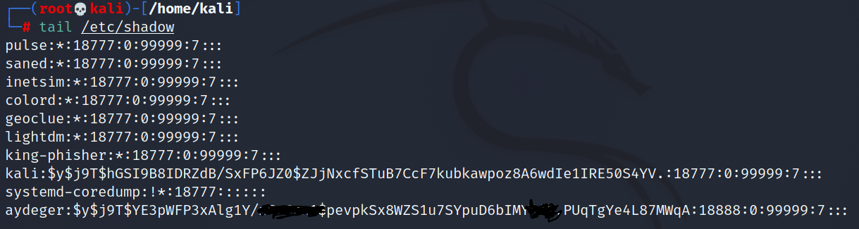
Hashed User Accounts in Kali
What can you do with this?

Slide 46
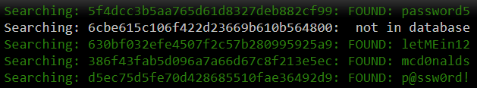
Lookup Tables
Lookup tables are an effective method for cracking many hashes of the same type very quickly
The general idea is to pre-compute the hashes of the passwords in a password dictionary and store them, and their corresponding password, in a lookup table data structure
A good implementation of a lookup table can process hundreds of hash lookups per second, even when they contain many billions of hashes

Slide 47
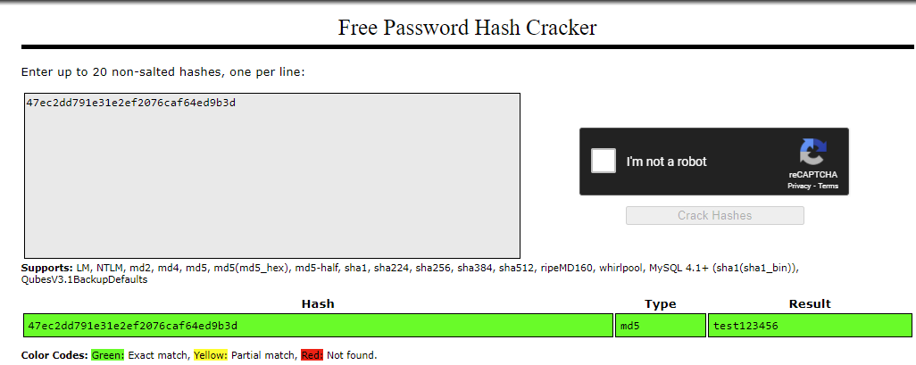
Online Hash Cracker (Lookup Table)
https://crackstation.net/

Slide 48
Password Cracking
Password cracking is one of the oldest hacking arts. Every system must store passwords somewhere in order to authenticate users. However, in order to protect these passwords from being stolen, they are encrypted. Password cracking is the art of decrypting the passwords in order to recover them.
A password cracking program if used ethically can be used by the system administrator to detect weak passwords amongst the system so they can be changed. A password Cracking program is most likely used to check the security of you’re your own system

Slide 49
Password Cracking Tools
John the Ripper (Our preference - Today's Topic)
HashCat / OCLHashCat / OCLHashCat+ (Recommended Tools)
SAMInside - Dictionary section has extremely basic rules (Approx 10) Prepend 1-2 characters - Append 1-2 characters.
L0phtCrack 6 - "Strong Password Audit - "common modifications“ consists of Prepending and/or Appending 2 characters.
ophcrack - Rainbow Tables Based - Brute Force
PasswordsPro - Supports the MOST formats of all tools Very slow to load input files with multiple passwords
Actually has a "Rules.txt" file very simular to John the Ripper - these rules are also almost as good as John's default ruleset.
Costs Money. (Approx $54 USD).
Cain/Abel - Free - Has really basic rules (reverse, Double, Case Subs, 2 numbers append, l33t rules)

Slide 50
Crack: John the Ripper
Crack is a type of password cracking utility that runs through combinations of passwords until it finds one that it matches. It also scans the content of a password file looking for weak login passwords.
John the Ripper is a fast password cracker, currently available for many flavors of Unix (11 are officially supported, not counting different architectures), DOS, Win32, BeOS, and OpenVMS. Its primary purpose is to detect weak Unix passwords. (openfirewall.com)

Slide 51


Attack Model
80d561388725fa74f2d03cd16e1d687c
50

Slide 52
Attack Model
80d561388725fa74f2d03cd16e1d687c
1. h(“123456”) = e10adc3949ba59abbe56e057f20f883e
51

Slide 53
Attack Model
80d561388725fa74f2d03cd16e1d687c
h(“123456”) = e10adc3949ba59abbe56e057f20f883e
h(“password”) = 5f4dcc3b5aa765d61d8327deb882cf99
52

Slide 54
Attack Model
80d561388725fa74f2d03cd16e1d687c
h(“123456”) = e10adc3949ba59abbe56e057f20f883e
h(“password”) = 5f4dcc3b5aa765d61d8327deb882cf99
h(“monkey”) = d0763edaa9d9bd2a9516280e9044d885
53

Slide 55
Attack Model
80d561388725fa74f2d03cd16e1d687c
h(“123456”) = e10adc3949ba59abbe56e057f20f883e
h(“password”) = 5f4dcc3b5aa765d61d8327deb882cf99
h(“monkey”) = d0763edaa9d9bd2a9516280e9044d885
h(“letmein”) = 0d107d09f5bbe40cade3de5c71e9e9b7
54

Slide 56
Attack Model
80d561388725fa74f2d03cd16e1d687c
h(“123456”) = e10adc3949ba59abbe56e057f20f883e
h(“password”) = 5f4dcc3b5aa765d61d8327deb882cf99
h(“monkey”) = d0763edaa9d9bd2a9516280e9044d885
h(“letmein”) = 0d107d09f5bbe40cade3de5c71e9e9b7
h(“p@ssw0rd”) = 0f359740bd1cda994f8b55330c86d845
55

Slide 57
Attack Model
80d561388725fa74f2d03cd16e1d687c
h(“123456”) = e10adc3949ba59abbe56e057f20f883e
h(“password”) = 5f4dcc3b5aa765d61d8327deb882cf99
h(“monkey”) = d0763edaa9d9bd2a9516280e9044d885
h(“letmein”) = 0d107d09f5bbe40cade3de5c71e9e9b7
h(“p@ssw0rd”) = 0f359740bd1cda994f8b55330c86d845
h(“Chic4go”) = 80d561388725fa74f2d03cd16e1d687c
56

Slide 58
How it works
Yes it cracks passwords, but how?
Uses a wordlist (supplied with the tool).
Uses a wordlist combined with "rules" that manipulate the wordlist.
Brute forces password possibilities based on statistics generated by the primary developer (and older tools).
These are roughly the same ideas that all password cracking software packages use

Slide 59
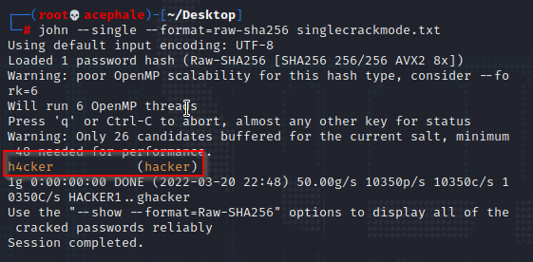
John Usage
John the Ripper works in 3 distinct modes to crack the passwords:
Single Crack Mode
Wordlist Crack Mode
Incremental Mode
Examples of Usage:
# john /etc/shadow
# john --wordlist=password.lst --rules passwd # john --show passwd

Slide 60
Crack: John the Ripper Stages
Though there are different types of password cracking utilities, most of these go through the same types of stages when trying to crack passwords:
-tries common passwords, such as "password" or the name of the account in question
-runs through all the words in the dictionary and lists of common passwords.
-runs through all the words in foreign dictionaries and special "crack" dictionaries.
-tries all combinations of letters out to a certain size, such as 5 letters.
-tries all combinations of letters, upper/lower case, numbers, and punctuation out to a certain size

Slide 61
Mangled Wordlist Attack
Wordlist
Super Password Chicago
60

Slide 62
Mangled Wordlist Attack
Wordlist Rulelist
Super Password Chicago
Append “1”
Replace “a” → “4”
Lowercase all
61

Slide 63
Mangled Wordlist Attack
Wordlist Rulelist
Guesses
Super Password Chicago
Append “1”
Replace “a” → “4”
Lowercase all
Super1
62

Slide 64
Mangled Wordlist Attack
Wordlist Rulelist
Guesses
Super Password Chicago
Append “1”
Replace “a” → “4”
Lowercase all
Super1
Password1
63

Slide 65
Mangled Wordlist Attack
Wordlist Rulelist
Guesses
Super Password Chicago
Append “1”
Replace “a” → “4”
Lowercase all
Super1 Password1 Chicago1
64

Slide 66
Mangled Wordlist Attack
Wordlist Rulelist
Guesses
Super Password Chicago
Append “1”
Replace “a” → “4”
Lowercase all
Super1 Password1 Chicago1 Super P4ssword Chic4go
65

Slide 67
Mangled Wordlist Attack
Wordlist Rulelist
Guesses
Super Password Chicago
Append “1”
Replace “a” → “4”
Lowercase all
Super1 Password1 Chicago1 Super P4ssword Chic4go super password chicago
66

Slide 68
Password Cracking:
Dictionary Attack & Brute Force
Pattern | Calculation | Result | Time to Guess (2.6x10¹⁸/month)
Personal Info: interests, relatives |  | 20 | Manual 5 minutes
Social Engineering |  | 1 | Manual 2 minutes
American Dictionary |  | 80,000 | < 1 second
4 chars: lower case alpha | 26⁴ | 5x10⁵
8 chars: lower case alpha | 26⁸ | 2x10¹¹
8 chars: alpha | 52⁸ | 5x10¹³
8 chars: alphanumeric | 62⁸ | 2x10¹⁴ | 3.4 min.
8 chars alphanumeric +10 | 72⁸ | 7x10¹⁴ | 12 min.
8 chars: all keyboard | 95⁸ | 7x10¹⁵ | 2 hours
12 chars: alphanumeric | 62¹² | 3x10²¹ | 96 years
12 chars: alphanumeric + 10 | 72¹² | 2x10²² | 500 years
12 chars: all keyboard | 95¹² | 5x10²³
16 chars: alphanumeric | 62¹⁶ | 5x10²⁸
Notes:
Calculation = <number of possible characters> to the <password length> power
Result is maximum number of guesses needed to find the right password.
This is taken from NIST, and assumes many computers are used in parallel to crack a password. Think criminal effort potentially using bots.

Slide 69
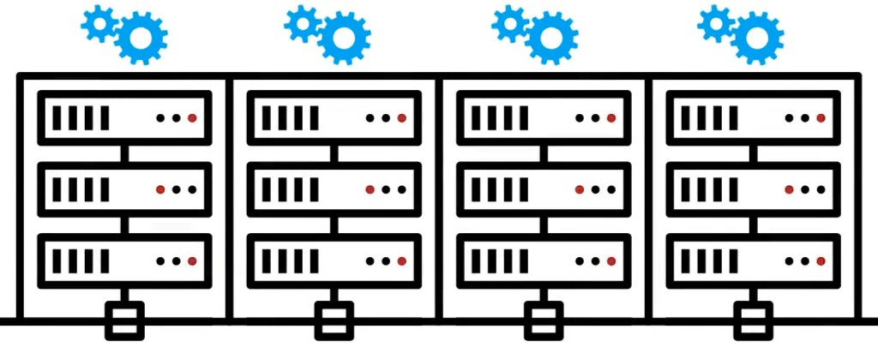
Neural Networks For Passwords
William Melicher, Blase Ur, Sean M. Segreti, Saranga Komanduri, Lujo Bauer, Nicolas Christin, Lorrie Faith Cranor. Fast, Lean, and Accurate: Modeling Password Guessability Using Neural Networks. In Proc. USENIX Security Symposium, 2016.
60

Slide 70

Better Password Scoring
Real-time feedback
Runs entirely client-side
Accurately models password guessability
Recurrent Neural Networks (RNNs)
LSTM Architecture
61
Image CC by Wes Breazell on the Noun Project

Slide 71

Pattern 123
Users love using '123' as their numbers:
!Austin123 | (summer123 | 123bali | 1234Wipro@
123Austin$ | 123!Saints | 123-Saints | 123dani
123August$ | !Elaine123 | 1!Brawn123 | 123dini
123August/ | 123Clipper! | 123$$$ | Photon1231!
Ferrari123 Jordan123 Austin#123
123roka123 1samuel$123 whatuwant@123
August@123 Clippers#123 August_123 $Dipesh123
whatwewant@123
In [List.Rules:Wordlist] - just add a line that says: $1$2$3

Slide 72
Current Year
Current Year: Lots of users will use the current year as their number:
!Jan2010 2010!! Work2010aha | May2010mjk | Sep2010mjk
020102mc Alps2010! ck2010ck | cl2010qt | Sept2010x
020104jo Augu2010$ | slm2010md | co2010je
2010! Winter2010a | Jam2010sic | Pal2010mine
Same idea as previous rule, place 2010 at the beginning, middle, end.
[List.Rules:KoreLogicRulesAdd2010Everywhere] i0[2]i1[0]i2[1]i3[0]
i1[2]i2[0]i3[1]i4[0]
i2[2]i3[0]i4[1]i5[0]
i3[2]i4[0]i5[1]i6[0]
i4[2]i5[0]i6[1]i7[0]
i5[2]i6[0]i7[1]i8[0]
i6[2]i7[0]i8[1]i9[0]

Slide 73
Current Year
# more foo.dic abcd
# john -w:foo.dic -stdout --rules:KoreLogicRulesAdd2010Everywhere 2010abcd
a2010bcd ab2010cd
abc2010d abcd2010
Use with wordlists not containing numbers. Just letters and specials.

Slide 74
Month/Year
Lets extrapolate this further, look at these sample passwords:
!Mar2010 | $Aug2010 | aug2010 | 1dec2010 @nov2010 $Mar2010
.Aug2010 | !Jun2010 | 5dec2010 | #nov2010 Jmar2010 =Aug2010
$Jun2010 | DEC2010 | $Nov2010 | MAR2010 AUG2010 .Jun2010
Dec2010 | %Nov2010 | Mar2010 | Aug2010 JUN2010 3nov2010
amar2010 | Kaug2010 | Jun2010 | =Nov2010 !Aug2010 P_aug2010
 | Ljun2010 | @Nov2010
These are based on Month/Year combinations.
If it is October of 2010, what do you think most of these passwords are going to be?

Slide 75
Current Year with a Special / Prepending Years
What about:
Jun2010! Lato2010! | Monkey2010! | Newyear2010! baby2010!
evg2010! Happy2010@ | Nove2010 | #password2010@
Hint: Use this with wordlists of letters only. 1-5 letters work best. (at first)
Why? Because we are supplying the numbers and special characters
for you.
Prepending Years works as well:
2010!Sep | 2010,Aug | 2010octs* | 2001Jeep | 2010! | 2010#
2010Jacob | 2010ly!! | 2001MARK | 2010!! | 2010#dec | 2001Papa
2010!.!. | 2010$Hello 2010time 2001abcd |  |  | 2010!Nov | 2010$Oct
2010tiny | 2001JUL | 2001andy 2010!Nove 2010+november
2010oct*T 2001JUN
2010September
2010Toyota

Slide 76
Months
What about all these months we keep seeing? They aren't always at the beginning and end. They can be in the middle.
!Oct-2010 | rnOct$ | 4Sep06 | 1983jan | 1may1982
!Oct1006 | wwOct05 | 1jan1191 | 1may1969 | $Oct06!
!Sep06 | CopSep1$ | 1jan1985 | 1may1976 | $#Oct999 | $$Sep123
1jan1993 | 05Oct$10 | $1Sep05 | augSep001 | 02may1977 | 27Oct2010
01jan | 19835may | AmyOct!1 | 409Sep89 | 01jan184 | 921may6
29Sep87% | ACSep*123 | Zq$$Sep9
What about passwords that end with Month and/or Dates?
04282may | 2006%May | BN@MAY2 .MAY77 | Simon@may08 | 0606MAY
2006.May | Dan&May1 | 1971May05 janemay01 | 13126may | ily14May
capemay7 | 1MAY06 | jkm@may22 14082may | 1985may7 | $21may70
2$MAY20 | vd@may29 | 1976@May 1989may9 | *09May08 | EJBmay17
2006!May | 1990may2 | .MAY07 Emilymay07

Slide 77
Months
What about passwords that have the _whole_ month in them:
January!12006 | February2008= | April$0410 | August/2008 | October&11
January!2006 | March#16 | April*26th | August132008! | October/2010$$
January#2006 | March#2008 | June%&2011 | SeptembeR2010 | december97
January101994 | March#3164 | June!22004 | Septem2010* | december98
January2010! February!2007 | March031708 March142010 | June/2007 August*2010 | September**123 | december@01
Also: 4 letter months
OCTO!!2 | Octo!200 | Octo2010! | Octob#10 | Nove2005!
OCTO!01 | Octo1957 | Octo2010!! | octoocto | Nove2005*
OCTO!2 | Octo1975 | Octo2010$ | NOVE!20 | Nove2005-
OctO1008 | Octo1998 | Octo2010$$ | NOVE&20 | Nove2006
OctO2008$ | Octo2**9 | Octob!!05 | Nove.2008 | OctOct09
Octo200$ | Octob!08 | Nove.2010 | Octo!!2005 | Octo200%
Octob!23 | Nove002.

Slide 78
Days of the Week
Also: Days of the week:
MONDAY. | Monday# | Monday0915$ | Friday*15
Thursday2.0 | MONDAY/ | Monday#01 | Tuesday%$888
Friday.56 | Thursday99= | MONDAY0 | Monday#123
friday@2010 | Thursday=01 | Monday!23 | TUESday180105
[List.Rules:KoreLogicRulesPrependDaysWeek] i0[mM]i1[oO0]i2[nN]i3[dD]i4[aA4@]i5[yY]
i0[tT]i1[uU]i2[eE3]i3[sS]i4[dD]i5[aA4@]i6[yY]
i0[wW]i1[eE]i2[nN]i3[dD]i4[sS]i5[dD]i6[aA4@]i7[yY]
i0[tT]i1[hH]i2[uU]i3[rR]i4[sS]i5[dD]i6[aA4@]i7[yY]
....

Slide 79
Users Love Numbers
Users love numbers!
By default john.conf has multiple rules that add numbers to wordlists. By default the following passwords can be cracked:
aaron698 windsor003 | Aimhigh300 | Austin934 | Buster172
aaron699 welcome222 | Alexis333 | Austin958 | Caitlin442
ababy420 welcome456 | Alliecat789 | Austin987 | Accounting785
and
ABcd4567 Abby0077 | Amanda5878 | ABcd5678 | Abby0206
Antigua4444 | ABcd6789 | Abby0217 | Antionette0824
By adding 3 or 4 numbers to the end of a wordlist.
But john.conf does not do this for all 3 or 4 numbers. Just a subset

Slide 80
Users Love Numbers
So we need rules that do the complete list (as seen earlier in presentation):
[List.Rules:KoreLogicRulesAppend4Num] c$[0123456789]$[0123456789]$[0123456789]$[0123456789]
$[0123456789]$[0123456789]$[0123456789]$[0123456789]
and [List.Rules:KoreLogicRulesAppend3Num]
c$[0123456789]$[0123456789]$[0123456789]
$[0123456789]$[0123456789]$[0123456789]
Sample output (for Append4Num):
Abcd0000 Abcd0001 Abcd0002 Abcd9998 Abcd9999 abcd0000 abcd0001 abcd0002 abcd9998 abcd9999

Slide 81
Users Love Numbers
Prepending with 2 Numbers (notice the first capital letter):
00Brandon | 01Bahadur | 01Jaguars |  | 01Otavalo |  | 99Gretzky | 00Presque
01Bigturd | 01Jarrett | 12Chucker |  | 99Matthew |  | 00Shootme | 01Bilusha
01Kokonut | 12Cowboys | 99Monster |  | 00Tiffany |  | 01Buttons | 01Latrice
12Cowboyz 00Welcome 01Megenza 13croatia |  |  |  |  |  | 00Zamboni | 01Hannahg
1Michael 13mandala 01Arianna 01Inferno |  |  |  |  |  | 01Olimpia | 13samurai
Prepending with 3 Numbers:
000Welcome | 003Kenneth |  | 009Bhuvana |  | 434Western |  | 866Rathman
001Bhuvana | 003welcome |  | 010Bhuvana |  | 444Chelsea |  | 888Welcome
001sanyika | 004Bhuvana |  | 012Brownis |  | 444Kriszta |  | 888Zachary
002Bhuvana | 005welcome |  | 100Alissar |  | 456Cowboys |  | 888userpwd
003Aisling 007welcome | 006welcome 429Wedding |  | 100IMedley 456Markske |  | 456Macbook |  | 003Bhuvana

Slide 82
Users Love Numbers
Prepending with 4 Numbers:
1236weather | 1921Wedding | 3029Jessica | 4119Fairway
8224Hunterz | 1315Marvick | 1928Lorenzo | 3042Sfiling
4122Wolfsun | 8231Incubus | 1324Booglet | 2007Chaunce
2049Kelibia | 4144Carroll | 9234Account | 1513Brandon
2015Wedding | 2060belmont | 4166Buffalo | 9234Cheengr
1522Salinas | 2017Jasmine | 2075Jasmine | 5199Eturkey
1526Katelyn | 2021WestGe | 2101Wedding | 5210Ansarah
1800troyboy | 2023Jillian
Prepend with 2 Numbers - Append 2 Numbers:
10Nico58 | 12cool12 | 56Moto97 | 20july83 | 55LOVE15
20Nori02 | 42csva07 | 01Polo86 | 30july95 | 85NIKE15
30PINK03 | 72cute92 | 46Quag17 | 12july99 | 45PAME15
40ango10 | 84baby12 | 0gamm12 | 50owen17 | 18amen02
50anna08 | 94bkjf41 | 60gary12 | 90paco12 | 48apoi89
70asis83 | 34cali14 | 30gfrc05 | 60paul17

Slide 83
Special Characters
Some password complexity rules requires users to use a special character in their password. Users treat these characters differently than letters, and use them sparingly.
Appending Special Characters:
thadeus! | antonio! | bubbles# Californi@ | CapeCoral@!
Simplyred! | FRANCE# | BonJovi@ dolphin, | Venice@!
Izabella! | GRANNY# | CITRIX@ cactus!@ | change@!
NYGiants! | Student# | Computer@cheese!@ | Cowboy@@
changeme!abcdefg# badgirl# Austin!@
clover!@
cheese@@ Dancing!
Dreamcatcher@ Lovemybabies@

Slide 84
Special Characters
Also, prepend a word with special character(s):
!!autumn | @@EMILY | @!pq10MZ | !1Clipper | !1q1q1q1q !!
deanna | !!Terry08 | @!qp10MZ | !1Jamie5 | !1qaz2wsx
##archie | !!abc123 | @!summer05 | !1Jamie5 | !4London
@!andrew | !!alex85 | !1London | !8Monday | @#Winter
!!die4me | !0Passwo | !1Monster | !9London | @@August
!@1234A | !0babies | !1Rebecca | !Firefox24 | @@DAVID
!@Cancer | !1Bridge | !1Sunny | !Linux01 | @#summer07

Slide 85
Special Characters
Additional "Specials" Patterns:
Append1_AddSpecialEverywhere:
Africa!1 Andyyu!1 T@Y!OR1 | AmyOct!1 john!deere1 b@byg!r1 | Kar!dani1 abi!abi1 Amanda!1 | XF!LES1 Alaya!1 A!lison1 | m!dnight1 AB!gail1 We!come1 |  | Ahoney!1
S!LVER1 Amelia7!1 |  | Ra!stlin1 Welcome!n1 |  |  | S0lar!s1
Append 2010Special:
oct2010! Aug2010$ |  | oct2010$ 26Dec2010! |  |  | Aug2010@
oct2010@ 2Cute2010! |  | october2010! Aaron2010! |  |  | Dublin2010!
pats2010! March2010! |  | eagles2010! Asia2010# |  |  | eagles2010$
Brooklyn2010@ Homegirl2010$ |  | odessa2010$ Januarybaby2010! |  |  | Alyssa2010!

Slide 86
Special Characters
Append4NumSpecial:
Abby1958$ Alex1005$ | Andre7000! | August2008$ | Chris0707$
Abcd1234! Alex1109$ | Athens2004$ | August2008. | Abcd1234$
Alex1209! April2007# | August2010! | Dece2010$ | Abcd1234^
Alex2008! August2008! August2008# | August2010$ Canada2010! | Alex0908$ | Alex2010!
Append6NumbersSpecial:
sl553015! uu124578! | iggy104215! | Fab240899! | Greg731133#
sl553016! oct192010! ee124578! Feb102010! Feb190207! ty092906! | baby112108! tt124578! fall051684! | Feb020905! eric200509! Fab240895! | ss201011!
Grace291133!
Sherry123456! Summer200810!

Slide 87
Special Characters
AppendNumberNumberSpecialSpecial:
AUTUMN08$$ Andrew49$$ | Baby33!! | Cadillac44$$ | January08$$
AUTUMN09$$ Aquaman12$$ | Bold08$$ | Dolfan00$$ | Abcd16$$
AteO00.. Saints01$$ Emma08!! Alex29$$ Cadillac33@@ Football33@@ Alex33$$ Baby09!! Henry23$$
August09$$ Cadillac33##
AppendSpecial4num:
Amy!2006 | Aug#2010 | Baby@0303 | 1nM@7352
Anala@2002 | Aug@1826 | Baby@1628 | Anand@1980
Aug@2000 | Dallas@2010 | September@2005 | 11vaca@2006
Andrew@1 | Aug@2004 | mn@2008 | 11Fire@0601
alexandria!2010
September#2010

Slide 88
Finger Patterns
Users also love finger patterns:
NHY^%tgb
!1234qwe
!@#123qwe
%1QWertyuiop
qwe~123 !23qweasd !QWERTY NHY^5tgb
!@#$QWE ASDFqwer qwertyqw !123qwer
(123qwe) ASDFqwer## 1qwe!QWE
john --external:keyboard (works, but is not perfect)
make your own (Or use KoreLogic’s)
Sometimes during corporate training classes, they will tell users to use this method. Take advantage of this fact!

Slide 89
Internet Related / Dev.Prod.Test.UAT
Internet related (These work REALLY well on Internet Apps):
0900.com 1723.com | YaL@agf.com | KOM.NET |  | aafp.org
1395.com 17jm.com 1828.com 1995.COM | gabriel.com @cox.net | capi.net ARMY.ORG |  | woop.org
Dev/Prod/Test/UAT Related:
Prod!111 prod@123 | TEST-CO | test!ng | webtest
Prod!121 UAT$2109 | TEST-DO | test-1234 | Prod!131
Uat$1234 Test@1109 | test.123 | silktest | Prod=332
Uat$2010 Test@123 | testftp | preprod1 | Prod=666
TEST-CA Test@cct | CFPTEST | preprod! | prod4321

Slide 90

Previous Passwords as Dictionary
So you've used all these rules to crack some passwords, what else can you do?
Use your cracked password as a dictionary!
# john -show --format:nt pwdump.txt | cut -d: -f 2 | sort -u > cracked.dic
or
# cut -d: -f2 john.pot | sort -u > cracked.dic
This is especially useful if you have :
Hashes from multiple systems
Password history files - (or hashes from previous months/years).
Large amounts of users
OWASP: Use the 'rockyou' list against your hashes!
Reuse all the "rules" using the new cracked.dic as the wordlist. Also..... (next slide)

Slide 91
Replace Numbers to Specials
Search/Replace Rules:
John's default john.conf has some of these. We have improved them.
Numbers -> Specials: Austin1 -> Austin! Testing222222 -> Testing222@@@ Dallas9 -> Dallas(
Replace Numbers -> Other Numbers: $Austin01 $Austin05 $Austin09 | Austin!01 | Austin!06
$Austin02 $Austin06 @Austin73 | Austin!02 | Austin!07
$Austin03 $Austin07 @Austin74 $Austin04 $Austin08 @Austin76 | Austin!04 Austin!05 | Austin!09

Slide 92
Replace Letters
Replace Letters -> Other Letters
austin12 Austin37 BOSTON1 | -> bustin12 -> Austin37 -> DOSTON1 | austin21 AUSTIN3 BOSTON1 | -> dustin21 -> AUSTIN3 -> FOSTON1
Austin11 | -> Bustin11 | Austin1$ | -> Rustin1$
Austin08. | -> Tustin08. | Austin16. | -> Vustin16.
Password1-> Cassword1 |  | Password#1 | -> Wassword#1
password -> bassword |  | password | -> cassword
Users will choose a password such as “Vegas2010” but when they are forced to change it – they will just change a single letter.
Example: Wegas2010 Vegaz2010

Slide 93
Hash with Salt
Lookup tables and rainbow tables only work because each password is hashed the exact same way
  If two users have the same password, they'll have the same password hashes
We can randomize the hashes by appending or prepending a random string, called a salt, to the password before hashing
  As shown in the example below, this makes the same password hash into a completely different string every time

Slide 94
Hash with Salt
The salt does not need to be secret
  Just by randomizing the hashes, lookup tables, reverse lookup tables, and rainbow tables become ineffective
  An attacker won't know in advance what the salt will be, so they can't pre-compute a lookup table or rainbow table
  If each user's password is hashed with a different salt, the reverse lookup table attack won't work either
Salt is usually stored in the user account database along with the hash, or as part of the hash string itself

Slide 95
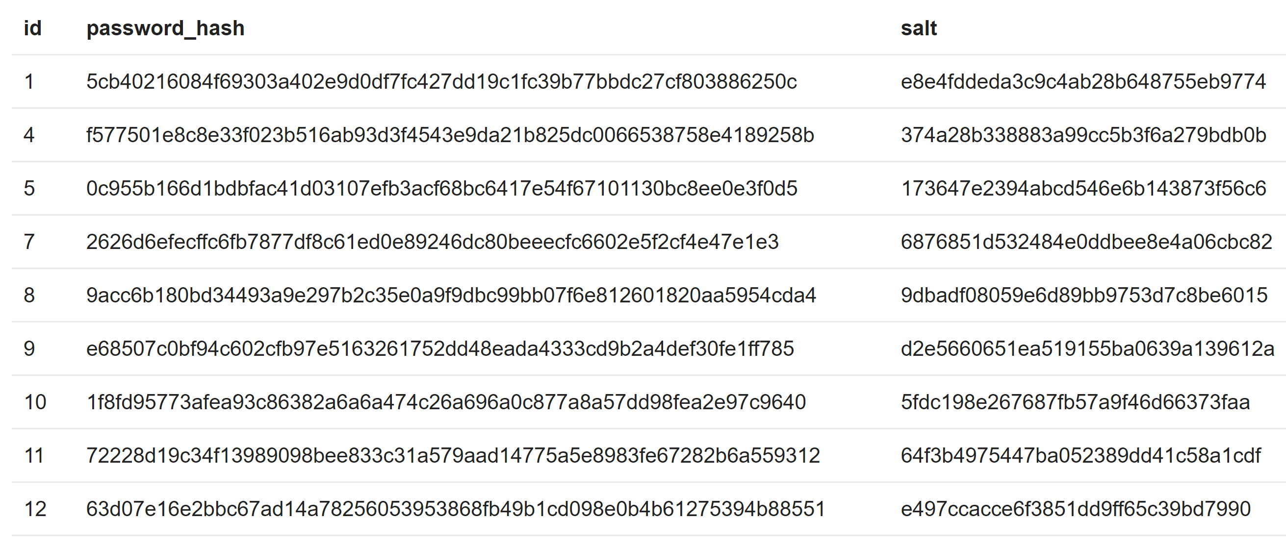
Example Database with Hash with Salt

Slide 96
Hacking Hash+Salt
If you can obtain (dump) the database
  Hashes and salt are stored there
  Just run dictionary attack with the hash and salt
Finding algorithm that is used for hashing:
  You can often tell by the format or the length of the hash
    For instance, a bcrypt hash usually begins with the marker $2b$
  Even simpler, if you know just one password (maybe you created your own account before the breach) you can try different algorithms on that one

Slide 97
Rainbow Tables
Much of the computation is done before the attack takes place, making it far easier and quicker to launch an attack, compared to other methods
The exact password string isn’t needed to be known
  If the hash is matched, it doesn’t matter if the string isn’t the password itself
The downside is the sheer volume of possible combinations often hundreds of gigabytes in size
  Some sell this data
https://freerainbowtables.com/
https://project-rainbowcrack.com/table.htm

Slide 98
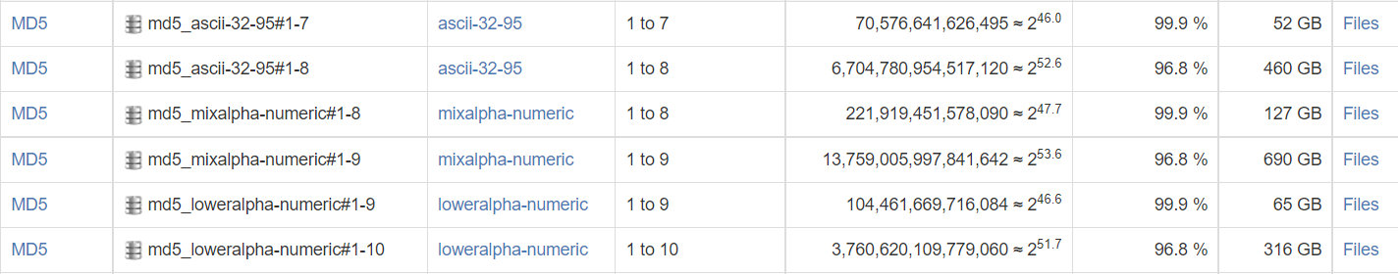
Rainbow Tables
Different features in the tables:

Slide 99
Slow Hash Functions
Salt ensures that attackers can't use specialized attacks like lookup tables and rainbow tables to crack large collections of hashes quickly
  But doesn't prevent them from running dictionary or brute-force attacks on each hash individually
High-end graphics cards (GPUs) and custom hardware can compute billions of hashes per second, so these attacks are still very effective
To make these attacks less effective, we can use a technique known as key stretching

Slide 100
Slow Hash Functions
The idea is to make the hash function very slow, so that even with a fast GPU or custom hardware, dictionary and brute-force attacks are too slow to be worthwhile
  But still fast enough to not cause a noticeable delay for the user
Example: PBKDF2
  For PHP
https://github.com/defuse/password-hashing

Slide 101
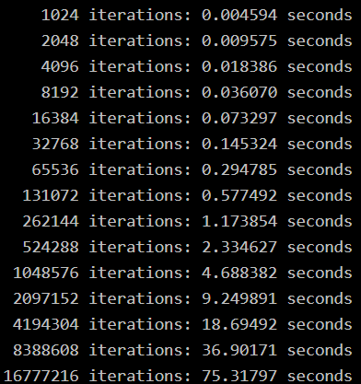
PBKDF2 For PHP
SHA256 hash function were run on an AMD Phenom 9600 2.3GHz CPU

Slide 102
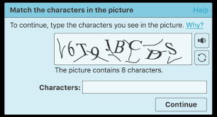
Problem with Slow Hash Functions
Potential DoS attack
Solution:
  Use Captcha for each login

Slide 103
Keyed Hashes
As long as an attacker can use a hash to check whether a password guess is right or wrong, they can run a dictionary or brute-force attack on the hash
The next step is to add a secret key to the hash so that only someone who knows the key can use the hash to validate a password
This can be accomplished two ways
  Either the hash can be encrypted using a cipher like AES
  Or the secret key can be included in the hash using a keyed hash algorithm like HMAC = H(key ∥ message)

Slide 104
Cracking Windows Passwords
L0phtCrack (LC7) can extract hashes from local or remote machine
Cain and Abel: variety of tasks including password cracking
John the Ripper: password auditing for 11 types of UNIX plus Windows
RainbowCrack and Ophcrack -> get the password by hash entered

Slide 105
Privilege Escalation
Exploiting OS or application
Path interception
Through DLL (Dynamic link library) injection
  If attacker can change real DLL with malicious one

Slide 106
Exploiting an Application
Using StickyKeys to Reset a Password
Sticky Keys enables users to enter key combinations by pressing keys in sequence rather than simultaneously
  5 times shift key
Although the method of enabling Sticky keys helps in simplifying various tasks, its system files can be replaced
  You can replace system file sethc.exe, with a Command Prompt, and then use cmd.exe to make system changes

Slide 107
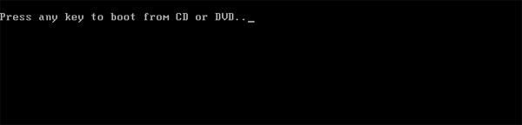
Using StickyKeys to Reset a Password
1. Boot your locked computer using your Windows 10 installation (or Linux) DVD
  If your computer doesn’t boot from it, you might need to change the boot order and disable UEFI secure boot
https://www.youtube.com/watch?v=gxLTKD0qZxc
https://www.top-password.com/blog/reset-windows-10-password-with-sticky-keys/
https://www.thewindowsclub.com/reset-administrator-password-windows-sticky-keys

Slide 108
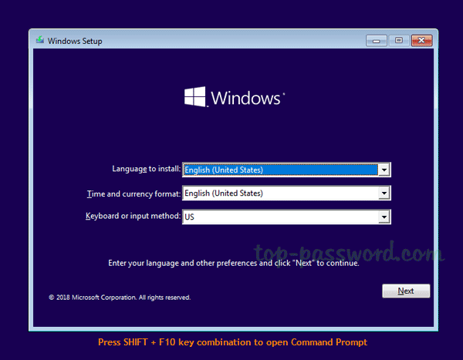
Using StickyKeys to
Reset a Password
2. After loading the installation files from the DVD, you’ll be shown the language setup screen
  Just press SHIFT + F10 key combinations to launch the Command Prompt

Slide 109
Using StickyKeys to Reset a Password
3. Enter the following two commands one by one, press Enter after each
  Replace c:\ with the correct drive letter if Windows is not mounted on
copy c:\windows\system32\sethc.exe c:\
copy /y c:\windows\system32\cmd.exe c:\windows\system32\sethc.exe

Slide 110
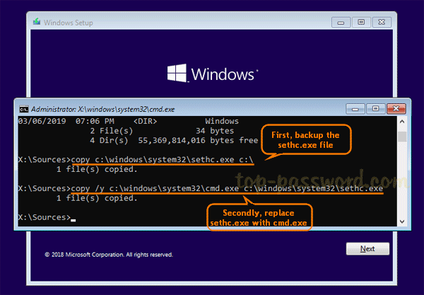
Using StickyKeys to Reset a Password

Slide 111
Using StickyKeys to Reset a Password
4. Next, run the following commands to disable Windows Defender as it may detect the sticky keys trick as a security alert called “Win32/AccessibilityEscalation“
reg load HKLM\temp-hive c:\windows\system32\config\SOFTWARE
reg add "HKLM\temp-hive\Policies\Microsoft\Windows Defender" /v DisableAntiSpyware /t REG_DWORD /d 1 /f
reg unload HKLM\temp-hive

Slide 112
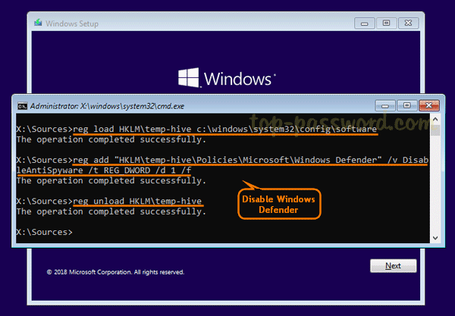
Using StickyKeys to Reset a Password

Slide 113
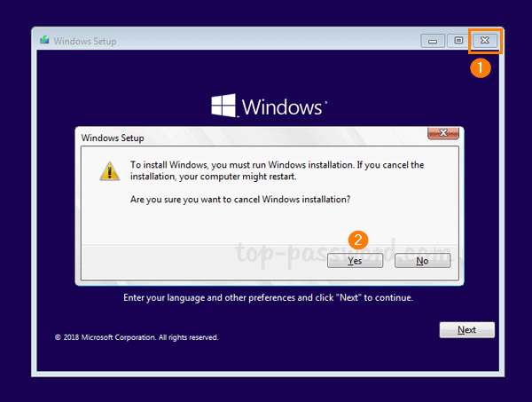
Using StickyKeys to Reset a Password
Close everything and cancel Windows Setup
Remove the installation disc and reboot

Slide 114
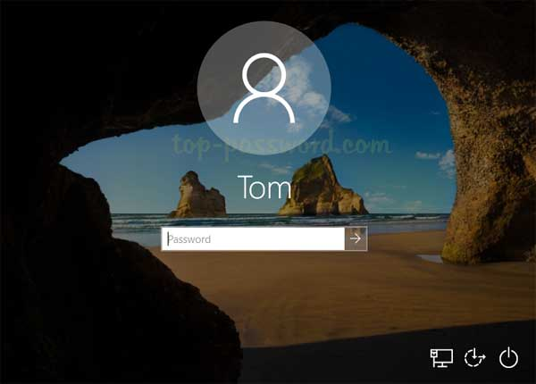
Using StickyKeys to Reset a Password
Once you get back to Windows 10 login screen, press the SHIFT key 5 times in a row, it will open the Command Prompt in administrator mode

Slide 115
Using StickyKeys to Reset a Password
Enter the following command to reset your lost Windows 10 password
  Substitute the name of the account to reset and a new password as appropriate
If you don’t know your account name, just type net user to list the available user names
net user user_name new_password

Slide 116
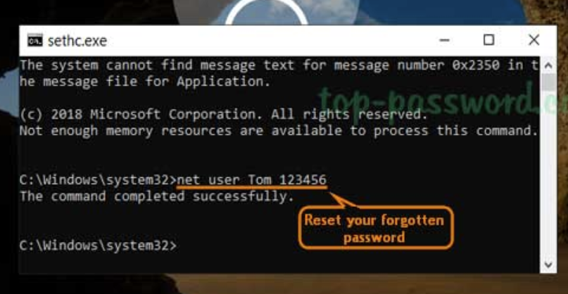
Using StickyKeys to Reset a Password

Slide 117
Using StickyKeys to Reset a Password
Close the Command Prompt and you can now login with your new password
After logging in, remember to restore the sethc.exe file and turn on Windows Defender real-time protection
This sticky keys method is quite well known and could be used to break into any Windows-based computer as long as you have physical access
How to prevent this?
  Just set a BIOS password to lock the boot sequence so others can’t boot from CD/USB

Slide 118
Questions?

